Slide 1
NAME :M.SIVA COLLEGE CODE : 6202 REGISTER NO : 620221104029

Slide 2
ABSTRACT
This project presents a review on the software program “Online Bus Ticket Reservation System” as should be used in a bus transportation system, a facility which is used to reserve seats, cancellation of reservation and different types of route enquiries used on securing quick reservations.
Structured Systems Analysis and Design Methodology (SSADM) was adopted.
It maintains all customer details, bus details, reservation details.
The software achieved is capable of improving the customer hand and relationship management in ITC operations.

Slide 3
PROBLEM STATEMENT
It stores customers’ personal data records, scheduled routes, frequent trips, drop points, and other information.
To provide customers with a personalized easy-to-utilize user experience for booking and purchasing tickets online.
A bus reservation system is a mobile or web software solution designed.

Slide 4
Project overview
I am providing a brief project description for every project.
A user-friendly project for booking and managing bus tickets.
Features include ticket booking, seat availability, cancellation, modification, and ticket history.
Clone, compile, and execute the project.

Slide 5
Technology view
The bus reservation technology landscape is continually evolving, with advancements in online booking platforms, mobile ticketing, and integration of smart features like GPS tracking and real-time updates.
Additionally, AI and machine learning are being employed to optimize routes, pricing, and customer service.
Overall, the focus is on improving convenience, efficiency, and the overall experience for travelers.

Slide 6
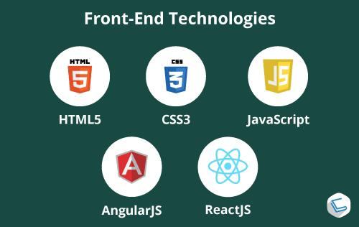
Front end

Slide 7
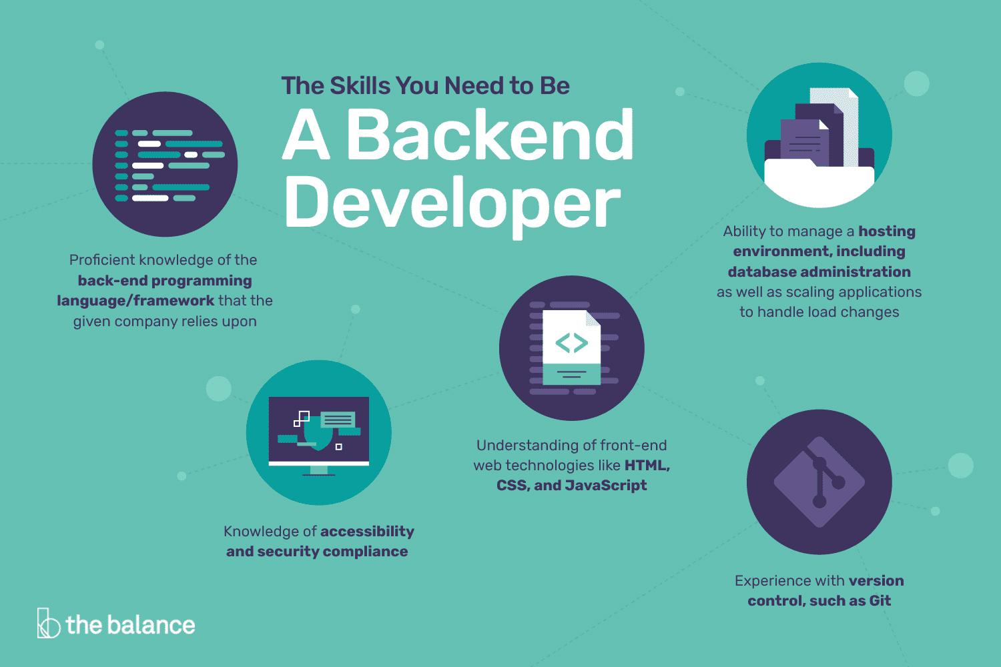
Back end

Slide 8
Modeling
Include information about available routes, departure and arrival times, and ticket prices.
Track which seats on each bus are available for reservation.
Enable users to securely pay for their reservations online.
Provide users with confirmation details after they successfully make a reservation.
Generate reports on reservation trends, revenue, and seat occupancy to help improve the service.

Slide 9
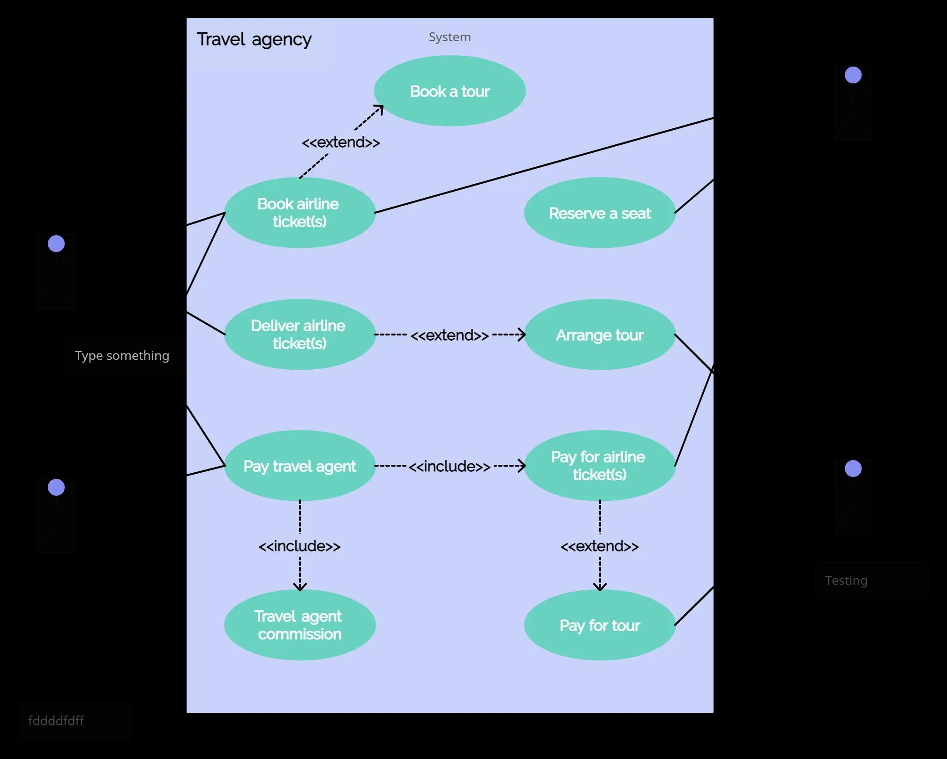

Slide 10
Result
A tool that allows users to book tickets for their journey in advance.
Users can access the system by entering their username and password.
The program expands the number of available seats while removing the passenger entry.
The program provides a collection of preconfigured users and their credentials.

Slide 11
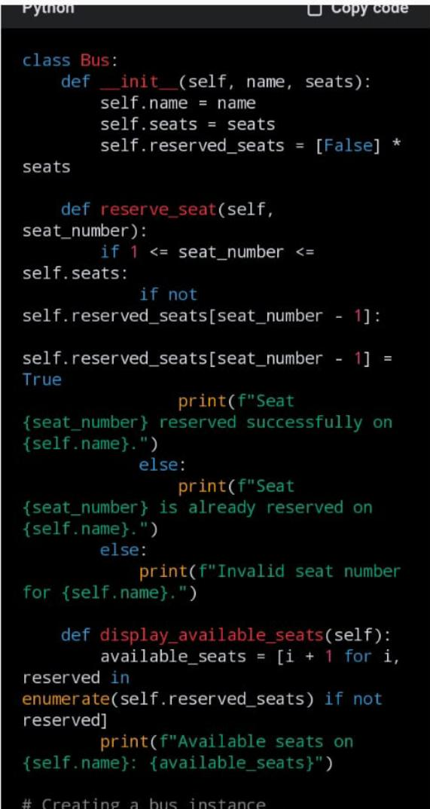
Screenshot

Slide 12
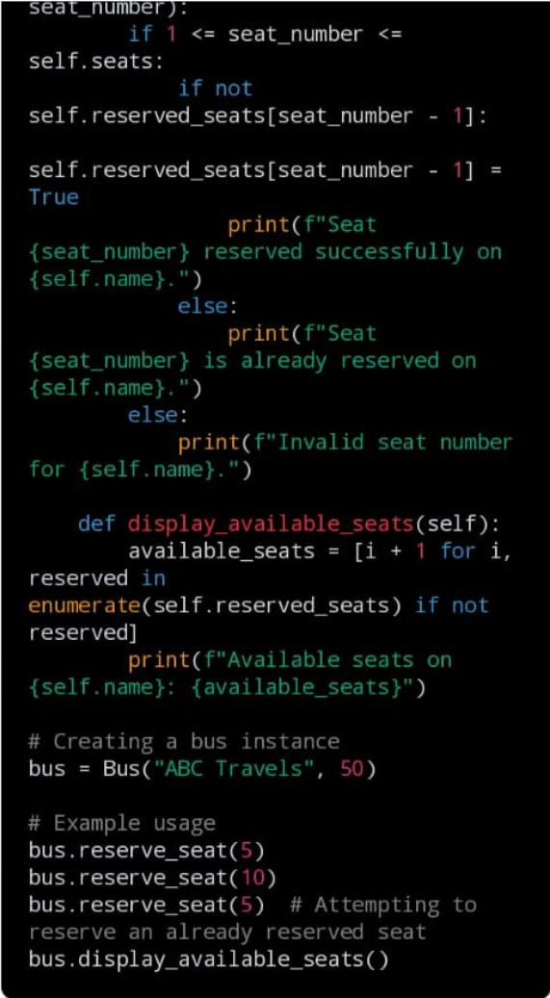

Slide 13
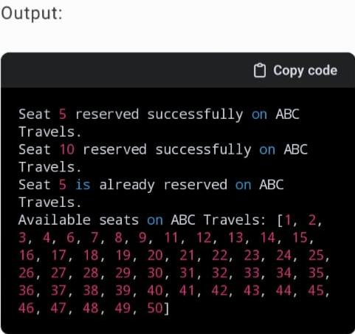

Slide 14
Future enhancement
Enhance the user experience by developing a dedicated mobile app for booking bus tickets, providing convenience and accessibility.
Integrate GPS technology to enable passengers to track the real-time location of buses, reducing wait times and enhancing travel planning.
Implement a feedback and rating system to gather passenger feedback and improve service quality continuously.
Allow passengers to choose their seats during the reservation process, providing them with more control over their travel experience.

Slide 15
Conclusion
To conclude, bus reservation systems offer convenience and efficiency for travelers, allowing them to book seats, choose routes, and make payments online or through mobile apps.
These systems streamline the booking process, reduce queues at ticket counters, and provide flexibility for travelers to plan their journeys. In conclusion, bus reservation systems play a crucial role in ensuring efficient transportation services for passengers.

Slide 16
THANK YOU

